Slide 1
EDGE DETECTION
4 Nov 2024

Slide 2
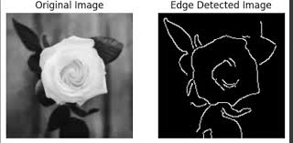
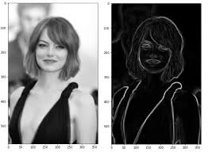
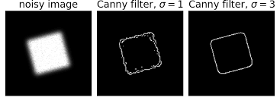
Applications:
Edge detection is widely used in computer vision, from object recognition to feature extraction and image segmentation, enabling machines to interpret visual information more effectively.

Slide 3
Edge detection
Edge detection in image processing is a technique used to identify the boundaries or edges within an image.
Edges are areas in an image where there is a sharp change in intensity, color, or texture, which often corresponds to object boundaries or significant features in the scene.
Detecting these edges is crucial for various tasks, such as object recognition, image segmentation, and computer vision applications, as it helps isolate and highlight important structures in the image.

Slide 4
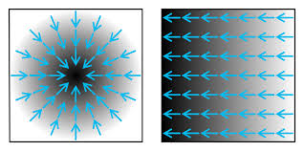
Gradients:
Edge detection typically involves calculating the gradient (rate of change) of pixel intensities across the image.
When there is a significant change, such as from a light area to a dark area, it indicates a potential edge.

Slide 5
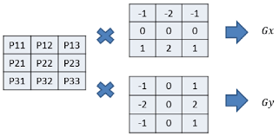
Filters:
Many edge detection algorithms use filters to highlight areas with strong gradients. Common filters include:
Sobel and Prewitt Filters: Calculate gradient magnitude in horizontal and vertical directions.
Canny Edge Detector: Combines gradient detection with noise reduction, edge thinning, and hysteresis thresholding, which makes it one of the most popular and effective methods.

Slide 6
Sobel edge detector
The Sobel edge detector works by applying convolution filters to an image to detect edges based on the changes in intensity, specifically the gradient.
It uses two 3x3 kernels (small matrices) to approximate the gradient in the horizontal (x) and vertical (y) directions.
These kernels are designed to emphasize the differences in intensity between adjacent pixels, highlighting areas where there’s a sharp change (an edge).

Slide 7
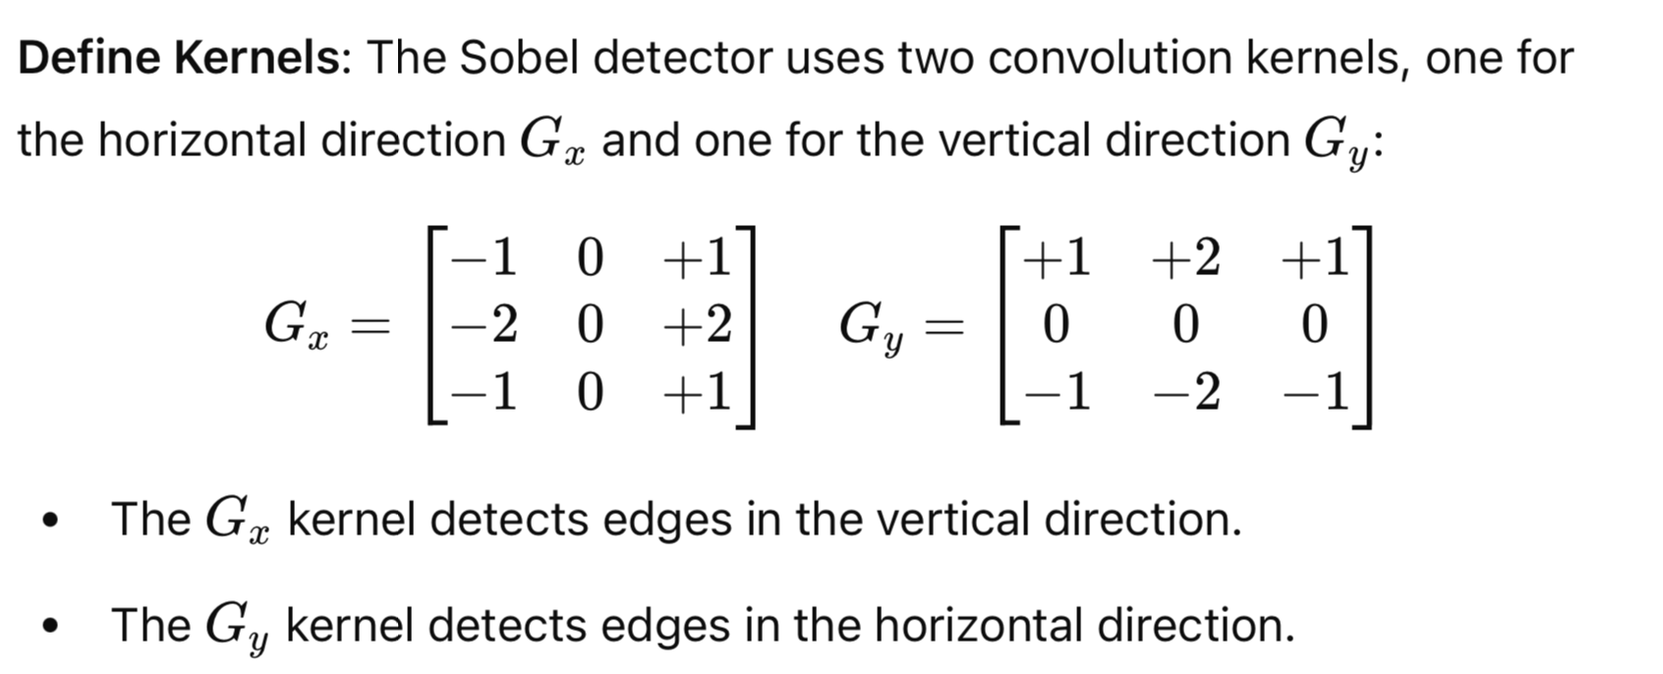
SOBEL KERNEL

Slide 8
Thresholding
Thresholding (Optional): To enhance edge clarity, a threshold can be applied to keep only strong gradients, effectively filtering out weak edges that may be noise.
This step makes the final edge image binary, showing clear edges in white against a black background.

Slide 9
Convolve the Image with Kernels:
The image is convolved with each kernel separately. Convolution involves sliding the kernel over the image and performing element-wise multiplication with the pixel values under the kernel, summing these values to produce an output pixel. This process creates two gradient images, I_{x}I_{x}​ and I_{y}I_{y}​, which contain the gradient information in the x and y directions, respectively.

Slide 10
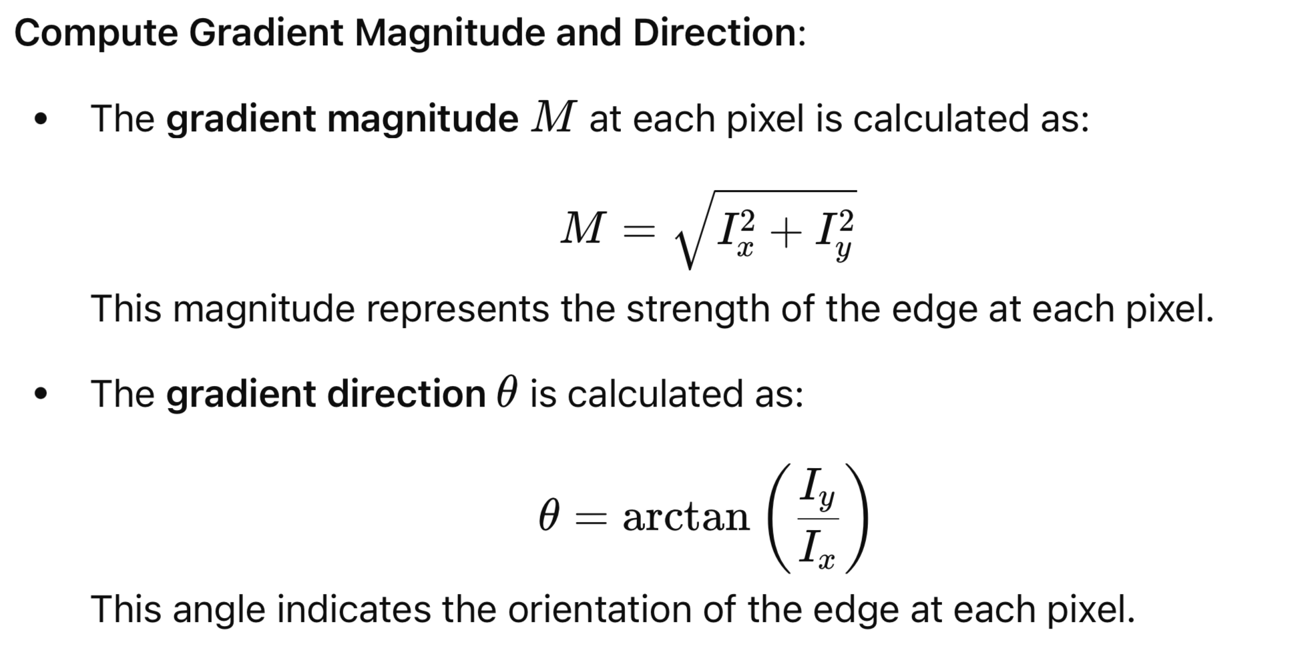

Slide 11
SOBEL OPERATOR CODE
import cv2
import numpy as np
import matplotlib.pyplot as plt
# Load the image and convert it to grayscale
image = cv2.imread('path_to_your_image.jpg', cv2.IMREAD_GRAYSCALE)
# Apply Sobel filter in x and y direction
# Gradient in x-direction
sobel_x = cv2.Sobel(image, cv2.CV_64F, 1, 0, ksize=3)
# Gradient in y-direction
sobel_y = cv2.Sobel(image, cv2.CV_64F, 0, 1, ksize=3)
# Compute the gradient magnitude
sobel_magnitude = np.sqrt(sobel_x**2 + sobel_y**2)
# Convert to 8-bit image for display
sobel_magnitude = np.uint8(np.absolute(sobel_magnitude))
# Display the results
plt.figure(figsize=(12, 8))
plt.subplot(1, 3, 1), plt.imshow(image, cmap='gray')
plt.title('Original Image'), plt.axis('off')
plt.subplot(1, 3, 2), plt.imshow(sobel_x, cmap='gray')
plt.title('Sobel X'), plt.axis('off')
plt.subplot(1, 3, 3), plt.imshow(sobel_y, cmap='gray')
plt.title('Sobel Y'), plt.axis('off')
plt.figure()
plt.imshow(sobel_magnitude, cmap='gray')
plt.title('Sobel Edge Magnitude'), plt.axis('off')
plt.show()

Slide 12
Explanation of Code
Load the Image: Read the image and convert it to grayscale, as edge detection typically operates on grayscale images.
Sobel Filters: Use cv2.Sobel to compute the gradients in the x and y directions:
cv2.Sobel(image, ddepth, dx, dy, ksize):
ddepth is the desired depth of the output image, cv2.CV_64F allows storing negative values.
dx and dy specify the order of the derivative in x and y directions.
Magnitude Calculation: Calculate the magnitude by combining sobel_x and sobel_y using the formula
= SQRT(sobel_{x}²+sobel_{y}²)​​.

Slide 13
Advantages
The Sobel detector highlights edges by emphasizing areas with high-intensity changes in the horizontal and vertical directions.
It’s often used in image processing for edge detection because it’s computationally efficient, easy to implement, and provides good results, particularly for identifying simple edges.

Slide 14
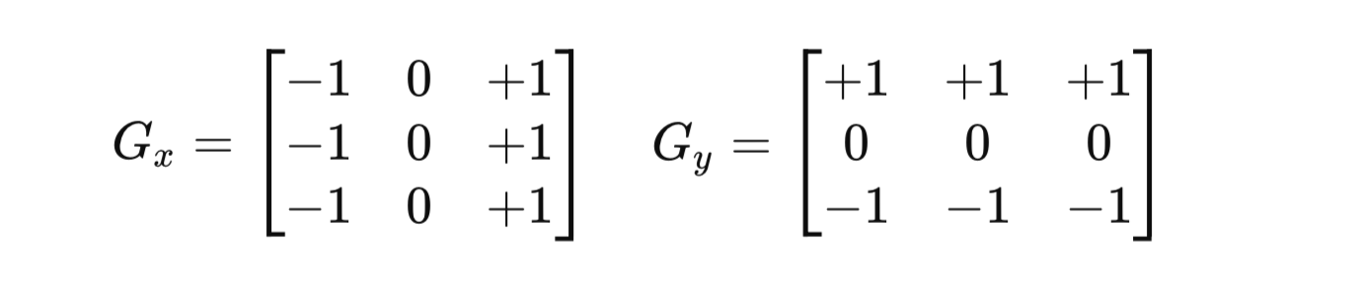
Prewitt Detector
The Prewitt edge detector is another gradient-based method similar to the Sobel detector.

Slide 15
Differences from Sobel
The Prewitt filter has simpler coefficients compared to the Sobel filter, making it slightly faster but less sensitive to diagonal edges.
It doesn’t weigh the center pixel as heavily as the Sobel filter, resulting in a more uniform emphasis across the neighboring pixels.

Slide 17
import cv2
import numpy as np
# Load the grayscale image
image = cv2.imread(‘orange.jpg', cv2.IMREAD_GRAYSCALE)
# Define the Prewitt kernels for x and y directions
prewitt_kernel_x = np.array([[1, 0, -1],
[1, 0, -1],
[1, 0, -1]])
prewitt_kernel_y = np.array([[1, 1, 1],
[0, 0, 0],
[-1, -1, -1]])
# Apply the Prewitt operator for x and y directions
prewitt_x = cv2.filter2D(image, -1, prewitt_kernel_x)
prewitt_y = cv2.filter2D(image, -1, prewitt_kernel_y)
# Combine the two results to get the gradient magnitude
prewitt_magnitude = cv2.magnitude(prewitt_x.astype(np.float32), prewitt_y.astype(np.float32))
# Convert the magnitude back to 8-bit for display
prewitt_magnitude = cv2.normalize(prewitt_magnitude, None, 0, 255, cv2.NORM_MINMAX).astype(np.uint8)
# Display the results
cv2.imshow('Original Image', image)
cv2.imshow('Prewitt X', prewitt_x)
cv2.imshow('Prewitt Y', prewitt_y)
cv2.imshow('Prewitt Magnitude', prewitt_magnitude)
cv2.waitKey(0)
cv2.destroyAllWindows()

Slide 18
Canny Filter
The Canny edge detector is a multi-stage algorithm for edge detection that was developed to overcome limitations in older methods like Sobel and Prewitt.
It is widely considered one of the most effective edge detection techniques due to its ability to detect a wide range of edges in images with minimal noise.
The algorithm consists of several stages designed to enhance edge accuracy and reduce noise.

Slide 19
Steps of the Canny Edge Detection

Slide 20
Noise Reduction (Gaussian Blur)
Since edge detection can be sensitive to noise, the first step is to smooth the image using a Gaussian filter.
This reduces the high-frequency noise, making edge detection more robust.
A Gaussian kernel is applied to blur the image, which helps focus the algorithm on significant intensity changes rather than random noise.

Slide 21
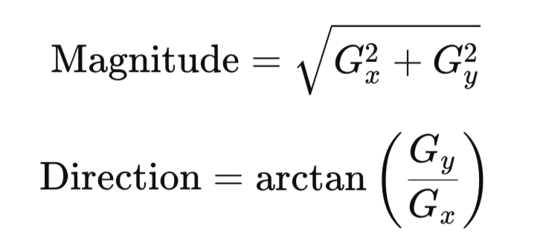
Compute Gradient Magnitude and Direction:
The smoothed image is then processed to find the intensity gradients in both the x and y directions, typically using Sobel filters.
The gradient magnitude (edge strength) and gradient direction (edge orientation) are calculated as:
These gradients reveal areas with sharp intensity changes, which are potential edges.

Slide 22
Non-Maximum Suppression:
Non-maximum suppression is applied to thin out the edges. This step eliminates pixels that are not at the local maximum in the direction of the gradient, making the edges thinner and sharper.
For each pixel, the algorithm checks adjacent pixels along the gradient direction to see if it’s the local maximum. If not, the pixel is set to zero, reducing false edges and sharpening the true edges.

Slide 23
Double Thresholding:
The algorithm uses two thresholds: a high threshold and a low threshold to classify edge pixels.
Strong edges: Pixels with gradient values above the high threshold are considered strong edges.
Weak edges: Pixels with gradient values between the low and high thresholds are considered weak edges.
Non-edges: Pixels below the low threshold are discarded as noise.
This double thresholding process helps keep important edges while minimizing noise and small fluctuations.

Slide 24
Edge Tracking by Hysteresis:
Edge tracking by hysteresis is performed. This step ensures that weak edges connected to strong edges are preserved, while isolated weak edges are discarded.
Pixels classified as weak but connected to strong edge pixels are retained as edges; otherwise, they are discarded. This step finalizes the edge map by linking relevant edge segments and removing spurious (fake/false) edges.

Slide 25
Summary
The Canny edge detector provides a detailed, noise-reduced, and well-defined edge map.
Its multi-step process of smoothing, gradient detection, non-maximum suppression, and double thresholding with hysteresis gives it superior edge detection performance compared to simpler detectors like Sobel and Prewitt.

Slide 26
Python Code
# Display the results
plt.figure(figsize=(8, 6))
plt.subplot(1, 2, 1), plt.imshow(image, cmap='gray')
plt.title('Original Image'), plt.axis('off')
plt.subplot(1, 2, 2), plt.imshow(edges, cmap='gray')
plt.title('Canny Edges'), plt.axis('off')
plt.show()
import cv2
import matplotlib.pyplot as plt
# Load the image and convert it to grayscale
image = cv2.imread(‘orange.jpg', cv2.IMREAD_GRAYSCALE)
# Apply Gaussian blur to reduce noise
blurred_image = cv2.GaussianBlur(image, (5, 5), 1.4)
# Apply Canny edge detection
edges = cv2.Canny(blurred_image, threshold1=50, threshold2=150)

Slide 27
Explanation
threshold1 and threshold2 are the low and high thresholds for double thresholding.
cv2.Canny applies all steps of the Canny edge detector, producing a clean and accurate edge map.

Slide 28
Exercise
What is the difference of
Sobel and Prewitt,
Roberts Cross,
Laplacian of Gaussian (LoG),
Canny operator-Gaussian filter.
Canny operator – median filter (since median preserves edges better that gaussian blur)
Give your own reason based on your experiment

